Slide 1



Efficient Top-k Ego-Betweenness Search
Qi Zhang, Rong-Hua Li, Minjia pan, Yongheng Dai, Guoren Wang, Ye Yuan
^{ICDE 2022}
汇报人：何智鹏 指导老师：欧阳典

Slide 2
目录
背景介绍
算法介绍
实验结果
总结与展望

Slide 3
研究背景

Slide 4
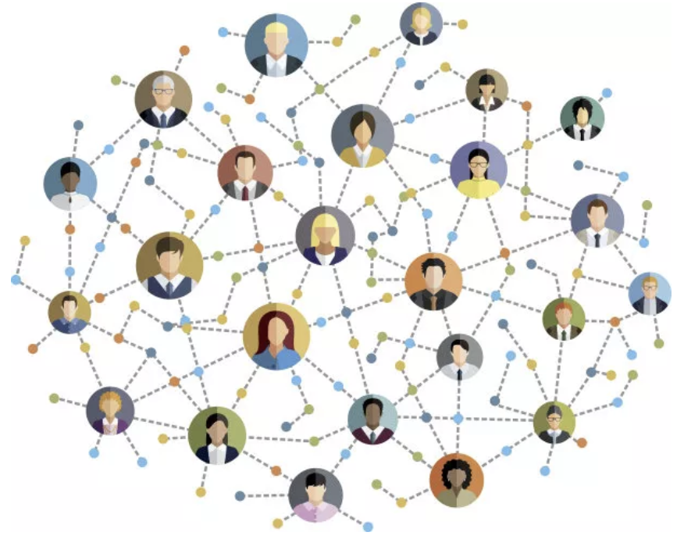
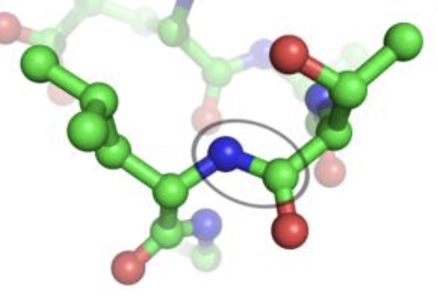

背景介绍
关键蛋白
重要用户
生物网络
社交网络
重要设施
通讯网络
Notes:
https://www.researchgate.net/figure/The-defined-Performance-ased-Standards-PBS-road-network-in-Australia-showing-PBS_fig4_265404087
Road network is a weighted graph. The weight of road can present distance and travel time. It is usually an approximate planar graph

Slide 5
研究背景
在图中怎样衡量一个节点是否重要？

Slide 6
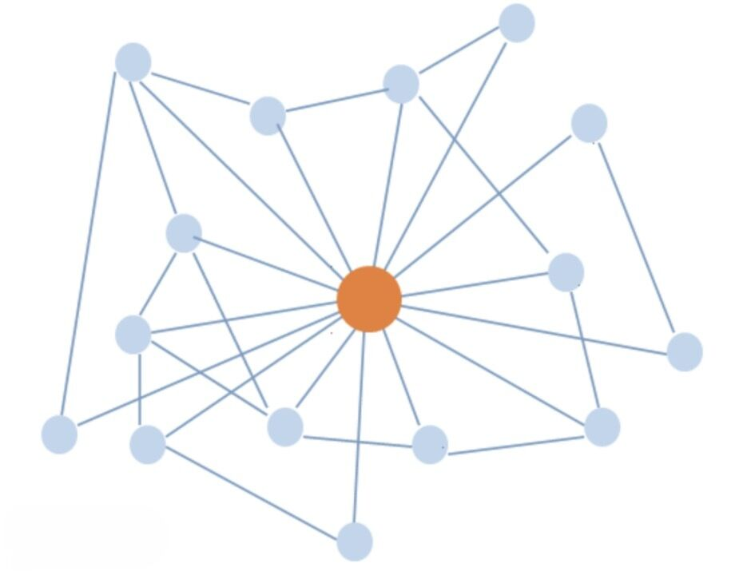
Degree Centrtality
在图中怎样衡量一个节点是否重要？
度

Slide 7
Betweenness Centrality
中介中心性

Slide 8
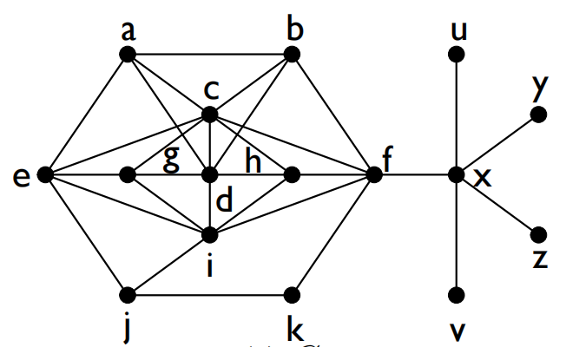
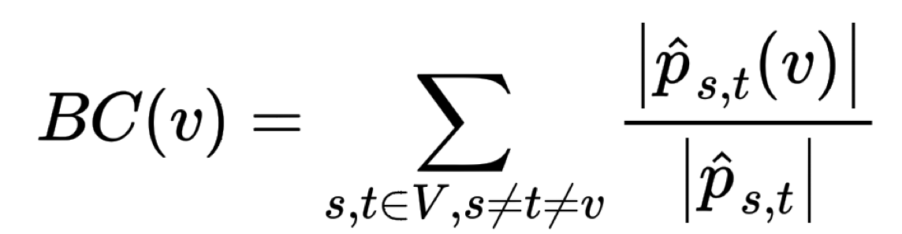
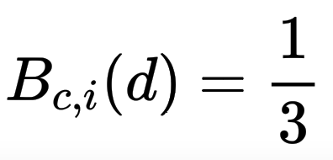

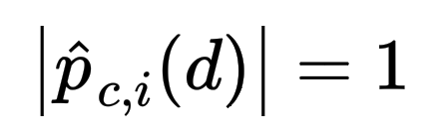
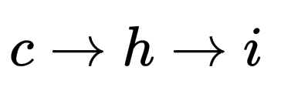
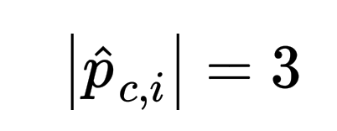

相关研究
Betweenness centrality
以经过某个节点的最短路径数目来刻画节点重要性的指标。简称BC。
计算网络中任意两个节点的所有最短路径，如果这些最短路径中很多条都经过了某个节点，那么就认为这个节点的中介中心性高。
这个有点像是我们身边那种社交达人，我们认识的不少朋友可能都是通过他/她认识的，这个人起到了中介的作用。
计算：
Notes:
https://www.researchgate.net/figure/The-defined-Performance-ased-Standards-PBS-road-network-in-Australia-showing-PBS_fig4_265404087
Road network is a weighted graph. The weight of road can present distance and travel time. It is usually an approximate planar graph

Slide 9
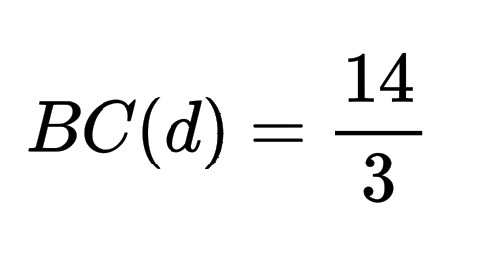
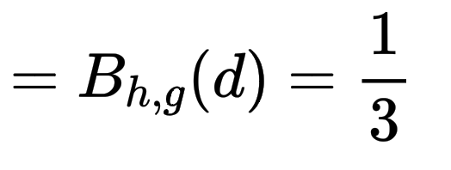
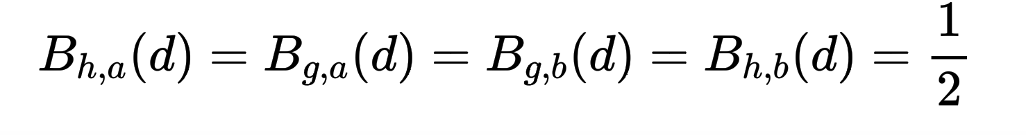
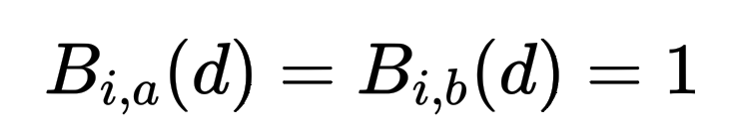
相关研究
Betweenness centrality
以经过某个节点的最短路径数目来刻画节点重要性的指标。简称BC。
计算网络中任意两个节点的所有最短路径，如果这些最短路径中很多条都经过了某个节点，那么就认为这个节点的中介中心性高。
这个有点像是我们身边那种社交达人，我们认识的不少朋友可能都是通过他/她认识的，这个人起到了中介的作用。
计算：
Notes:
https://www.researchgate.net/figure/The-defined-Performance-ased-Standards-PBS-road-network-in-Australia-showing-PBS_fig4_265404087
Road network is a weighted graph. The weight of road can present distance and travel time. It is usually an approximate planar graph

Slide 10
相关研究
Betweenness
一个顶点的BC值通常很难计算，因为它需要探索与其他顶点之间的所有最短路径；
这样的时间复杂度只有在具有几万个顶点和边的小图中才能被接受，但对于具有数百万个顶点和数亿条边的现代网络来说代价十分昂贵。
Notes:
https://www.researchgate.net/figure/The-defined-Performance-ased-Standards-PBS-road-network-in-Australia-showing-PBS_fig4_265404087
Road network is a weighted graph. The weight of road can present distance and travel time. It is usually an approximate planar graph

Slide 11
Ego-Betweenness

Slide 12


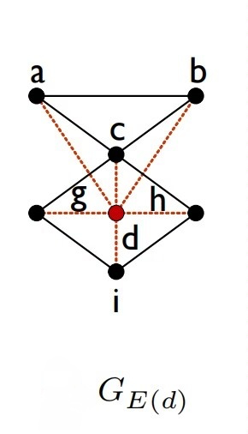
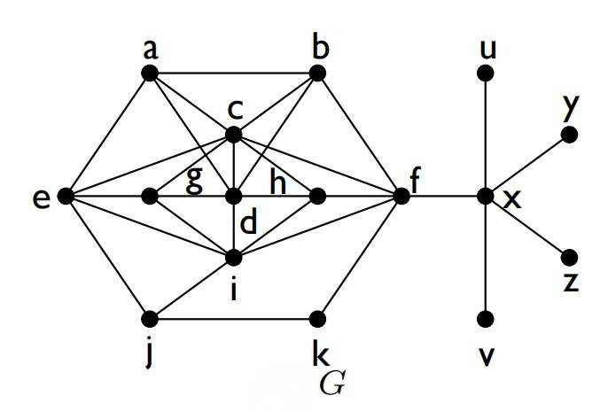

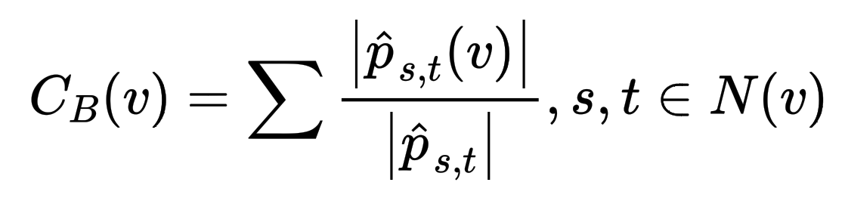
算法介绍
Ego-network
对于G=(V,E)中的顶点v，用N(v)来表示一个顶点v的邻居的集合，v的自我网络用 表示，它是由顶点集 诱导的G的一个子图。
Ego-betweenness
G中一个顶点v 的ego-betweenness值用 来表示，其定义为：
Notes:
In accommodation-booking services such as Booking and Airbnb, a basic operation is to show several accommodations that are the closest to the location assigned by a user.
In restaurant-review services like Yelp, service providers need to present several restaurants near the user. In taxi-hailing services like Uber, several available vehicles near the pickup location are presented for users before they send the request.

Slide 13
算法介绍
Ego-network
对于G=(V,E)中的顶点v，用N(v)来表示一个顶点v的邻居的集合，v的自我网络用 表示，它是由顶点集 诱导的G的一个子图。
Ego-betweenness
G中一个顶点v 的ego-betweenness值用 来表示，其定义为：
只需在自我网络中计算顶点的BC值，避免高计算成本问题；
现实生活的需求当中通常需要检索具有最高Ego-betweenness值的前k个顶点，而不是所有顶点的精确值。
Notes:
In accommodation-booking services such as Booking and Airbnb, a basic operation is to show several accommodations that are the closest to the location assigned by a user.
In restaurant-review services like Yelp, service providers need to present several restaurants near the user. In taxi-hailing services like Uber, several available vehicles near the pickup location are presented for users before they send the request.

Slide 14
如何有效地求前k个？
BaseBSearch
一个简单的算法是计算每个顶点的ego-betweeneness，然后进行排序选择前k个顶点作为答案

Slide 15


算法介绍
Top-k Ego-Betweenness Search框架
输入图G=(V,E)，整数k>=1
设定上界 进行剪枝
比较顶点的 值和上界
输出包含k个顶点的结果集
Notes:
In accommodation-booking services such as Booking and Airbnb, a basic operation is to show several accommodations that are the closest to the location assigned by a user.
In restaurant-review services like Yelp, service providers need to present several restaurants near the user. In taxi-hailing services like Uber, several available vehicles near the pickup location are presented for users before they send the request.

Slide 16
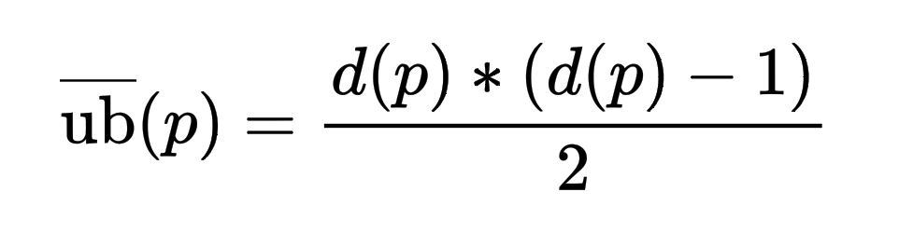
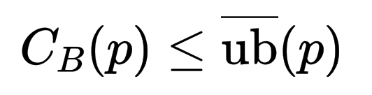


算法介绍
Top-k Ego-Betweenness Search
BaseBSearch
：设定一个上界策略来对搜索空间进行剪枝
输入：图G，k=5。
输出：ego-betweeeness值较大的前k个顶点
v
c
i
f
d
x
e
h
g
b
a
21
15
15
10
10
6
6
6
6
6
41/6
8
11
14/3
10
R
{c}
{i,c}
{f,i,c}
{f,i,c,
d}
{f,x,i,c,d}
Notes:
In accommodation-booking services such as Booking and Airbnb, a basic operation is to show several accommodations that are the closest to the location assigned by a user.
In restaurant-review services like Yelp, service providers need to present several restaurants near the user. In taxi-hailing services like Uber, several available vehicles near the pickup location are presented for users before they send the request.

Slide 17
算法介绍
Top-k Ego-Betweenness Search
BaseBSearch
：设定一个上界策略来对搜索空间进行剪枝
输入：图G，k=5。
输出：ego-betweeeness值较大的前k个顶点
v
c
i
f
d
x
e
h
g
b
a
21
15
15
10
10
6
6
6
6
6
41/6
8
11
14/3
10
4.5
2/3
2/3
1
1
R
{c}
{i,c}
{f,i,c}
{f,i,c,
d}
{f,x,i,c,d}
剩下的节点：j, k, u, v, x, y, z当中，最大的
Notes:
In accommodation-booking services such as Booking and Airbnb, a basic operation is to show several accommodations that are the closest to the location assigned by a user.
In restaurant-review services like Yelp, service providers need to present several restaurants near the user. In taxi-hailing services like Uber, several available vehicles near the pickup location are presented for users before they send the request.

Slide 18
算法介绍
Top-k Ego-Betweenness Search
BaseBSearch
：设定一个上界策略来对搜索空间进行剪枝
输入：图G，k=5。
输出：ego-betweeeness值较大的前k个顶点
v
c
i
f
d
x
e
h
g
b
a
21
15
15
10
10
6
6
6
6
6
41/6
8
11
14/3
10
4.5
2/3
2/3
1
1
R
{c}
{i,c}
{f,i,c}
{f,i,c,
d}
{f,x,i,c,d}
剩下的节点：j, k, u, v, x, y, z当中，最大的
与计算出全部节点的ego- betweenness值再选出前k个大的方法相比，BaseBSearch利用上界策略可以节省6个ego-betweenness的计算代价。
Notes:
In accommodation-booking services such as Booking and Airbnb, a basic operation is to show several accommodations that are the closest to the location assigned by a user.
In restaurant-review services like Yelp, service providers need to present several restaurants near the user. In taxi-hailing services like Uber, several available vehicles near the pickup location are presented for users before they send the request.

Slide 19
实验结果

Slide 20
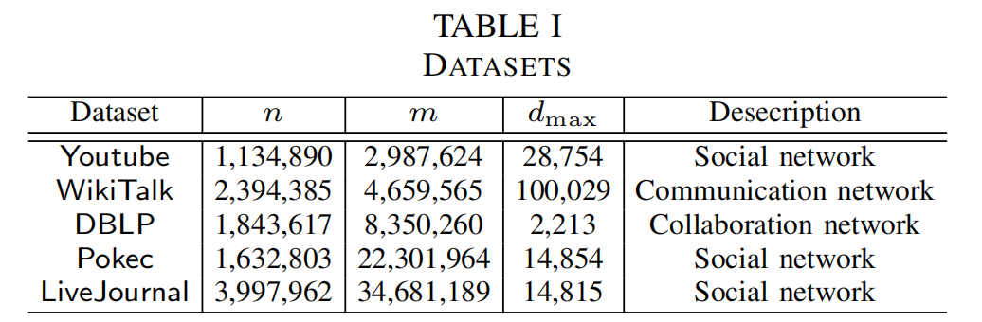
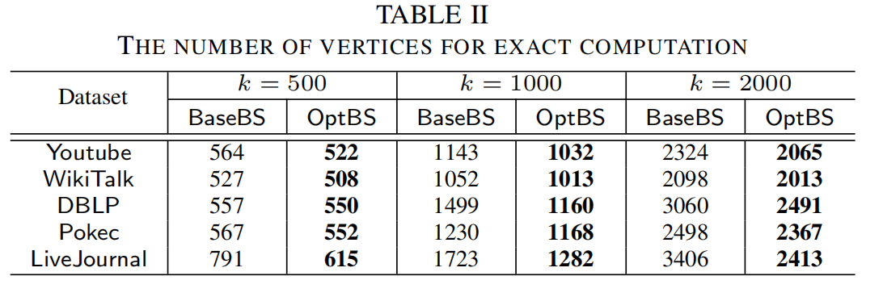
Experiment
数据集：5个真实世界中的复杂网络

Slide 21
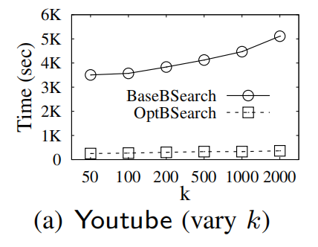
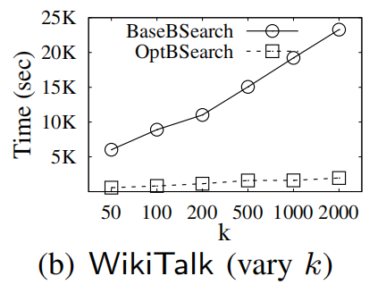
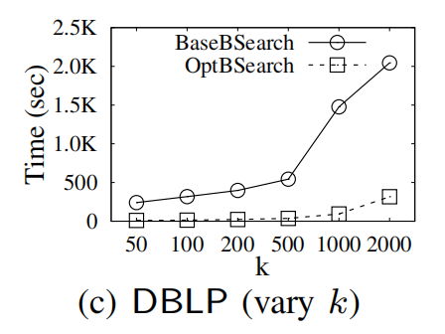
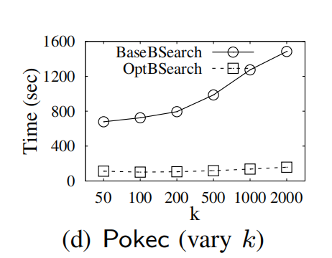
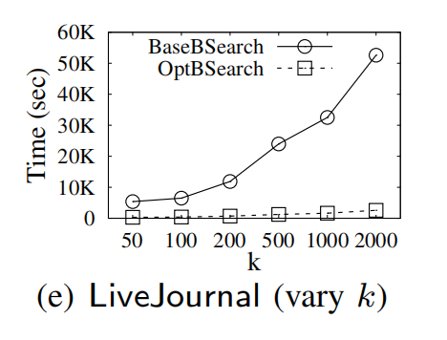
Experiment
不同数据集上的运行时间

Slide 22
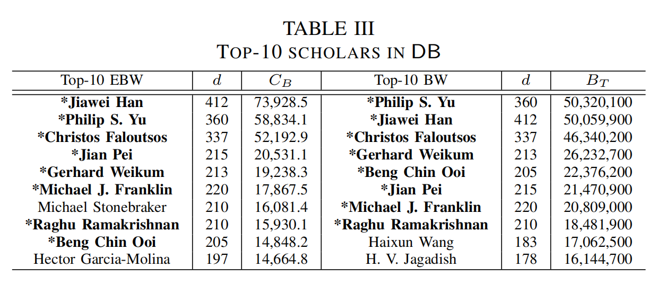
Experiment
关于DBLP排名前10的学者
重叠率达到了80%，ego-betweennes可以替代betweenness作为衡量指标
这些结果表明，作者的算法可以用于查找网络中充当网络桥梁的高影响力顶点

Slide 23
总结与展望

Slide 24
Summary
总结
betweenness是衡量网络中一个顶点重要性的关键指标，然而，一个顶点的betweenness通常很难计算，因为它需要遍历其他顶点之间的所有最短路径，在大图中应用是不现实的；
于是作者引入ego-betweenness，这样只需关注所求顶点与它邻居组成的自我网络即可；
设定一个上界策略来对搜索空间进行剪枝来节省计算代价。
展望：在大图求最短路方法中，通常需要对关键点进行选取来加速路径查询的时间效率，本论文的方法可以为地标、关键点选择策略提供更好的辅助。

Slide 25
Thank you!

